Slide 1
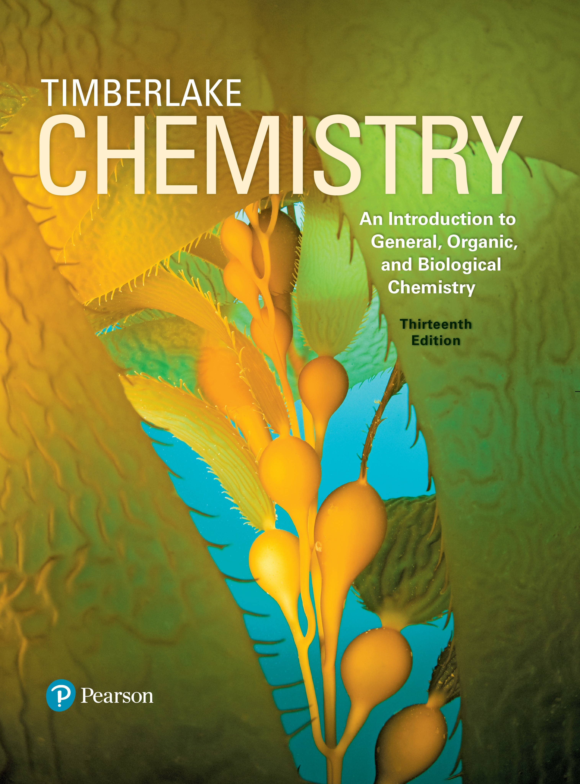
Chemistry: An Introduction to General, Organic, and Biological Chemistry
Thirteenth Edition
Chapter 16
Amino Acids, Proteins, and Enzymes
Copyright © 2018, 2015, 2012 Pearson Education, Inc. All Rights Reserved
Notes:
If this PowerPoint presentation contains mathematical equations, you may need to check that your computer has the following installed:
1) MathType Plugin
2) Math Player (free versions available)
3) NVDA Reader (free versions available)

Slide 2
Amino Acids, Proteins, and Enzymes
Many physician assistants take on the role of the primary caregiver.
Their duties may include
obtaining patient medical records and histories
diagnosing illnesses
educating and counseling patients
referring the patient, when needed, to a specialist

Slide 3
16.1 Proteins and Amino Acids
Proteins are one of the most prevalent types of molecules in living organisms.
The horns of animals are made of proteins.
Learning Goal Classify proteins by their functions. Give the name and abbreviations for an amino acid and draw its structure at physiological p H.

Slide 4
Functions of Proteins
Proteins
in the body are polymers made from 20 different amino acids
differ in characteristics and functions that depend on the order of amino acids that make up the protein
form structural components such as cartilage, muscles, hair, and nails
function as enzymes to regulate biological reactions such as digestion and cellular metabolism
such as hemoglobin and myoglobin transport oxygen in the blood

Slide 5
Structural Classification of Proteins
Table 16.1 Classification of Some Proteins and Their Functions
Class of Protein | Function | Examples
Structural | Provide structural components | Collagen is in tendons and cartilage. Keratin is in hair, skin, wool, and nails.
Contractile | Make muscles move | Myosin and actin contract muscle fibers.
Transport | Carry essential substances throughout the body | Hemoglobin transports oxygen. Lipoproteins transport lipids.
Storage | Store nutrients | Casein stores protein in milk. Ferritin stores iron in the spleen and liver.
Hormone | Regulate body metabolism and the nervous system | Insulin regulates blood glucose level. Growth hormone regulates body growth.
Enzyme | Catalyze biochemical reactions in the cells | Sucrase catalyzes the hydrolysis of sucrose. Trypsin catalyzes the hydrolysis of proteins.
Protection | Recognize and destroy foreign substances | Immunoglobulins stimulate immune responses.

Slide 6
Amino Acids
Amino acids, the molecular building blocks of proteins,
have a central carbon atom called the
-carbon bonded
to two functional groups: an ammonium group
and a carboxylate group
have a central carbon atom bonded to a hydrogen atom and R group or side chain in addition to the carboxylate and ammonium groups

Slide 7
Classification of Amino Acids
Amino acids are classified as
nonpolar (hydrophobic) with hydrocarbon side chains
polar (hydrophilic) with polar or ionic side chains
Nonpolar Valine
Polar Asparagine

Slide 8
Nonpolar Amino Acids
An amino acid is nonpolar when the R group is H, alkyl, or aromatic.
Table 16.2 Structures, Names, and Abbreviations of 20 Common Amino Acids at Physiological p H (7.4)
Notes:
• Glycine, abbreviated G l y or G, has the R group as a hydrogen.
• Alanine, abbreviated Ay l ay or Ay, has the R group as a methyl group.
• Valine, abbreviated V ay l or V, has the R group as a carbon bonded to 2 methyl groups.
• Leucine, abbreviated L e u or L, has the R group as a chain of 2 carbons with the last bonded to 2 methyl groups.
• Isoleucine, abbreviated I l e or I, has the R group as a chain of 3 carbons with a side methyl group on the first carbon.
• Phenylalanine, abbreviated P h e or P, has the R group as a carbon bonded to a benzene ring.
• Methionine, abbreviated M e t or M, has the R group as a chain of 2 carbons bonded to a sulfur bonded to a methyl group.
• Proline, abbreviated P r o or P, has the R group as a chain of 3 carbons, with the third carbon bonded to the nitrogen of the now N H 2, plus group on the alpha carbon. Note, proline is a cyclic amino acid because its R group bonds to the nitrogen atom attached to the alpha carbon.
• Tryptophan, abbreviated T r p or W, has the R group as a carbon bonded to a carbon of a 5-carbon ring. This carbon in the ring is double-bonded to an adjacent carbon, which is adjacent to a nitrogen in the ring. The nitrogen is bonded to a hydrogen. The remaining 2 carbons in

Slide 9
Polar Amino Acids
An amino acid is polar when the R group is a hydroxyl, a thiol, or an amide.
Table 16.2 Structures, Names, and Abbreviations of 20 Common Amino Acids at Physiological p H (7.4)
Notes:
• Serine, abbreviated S e r and S, has the R group as a carbon bonded to a hydroxyl group.
• Threonine, abbreviated T h r or T, has the R group as a chain of 2 carbons, the first bonded to a hydroxyl group.
• Tyrosine, abbreviated T y r or Y, has the R group as a carbon bonded to a benzene ring, with the opposite carbon on the ring bonded to a hydroxyl group.
• Cysteine, abbreviated C y s or C, has the R group as a carbon bonded to an S H group.
• Asparagine, abbreviated Ay s n or N, has the R group as a carbon bonded to a carbonyl group bonded to an N H 2 group.
• Glutamine, abbreviated G l n or Q, has the R group as a chain of 2 carbons bonded to a carbonyl group bonded to an N H 2 group.

Slide 10
Acidic Amino Acids
An amino acid is acidic when the R group is a carboxylate.
Table 16.2 Structures, Names, and Abbreviations of 20 Common Amino Acids at Physiological p H (7.4)
Notes:
• Aspartate, abbreviated A s p or D, has the R group as a C H 2 group single bonded to a carbon which is double bonded to an oxygen atom and single bonded to O minus.
• Glutamate, abbreviated G l u or E, has the R group as a 2 carbon chain bonded to a carbon which is double bonded to an oxygen atom and single bonded to O minus.

Slide 11
Basic Amino Acids
An amino acid is basic when the R group is an amine, which ionizes to give an ammonium ion.
Table 16.2 Structures, Names, and Abbreviations of 20 Common Amino Acids at Physiological p H (7.4)
Notes:
• Histidine, abbreviated H i s or H, has the R group as C H 2 single bonded to a 5 sided ring with 2 double bonds. The upper left and upper right points of the ring are occupied by nitrogen atoms single bonded to hydrogen atoms. The nitrogen adjacent to the C H 2 is N plus. Note, at physiological pH, some histidine molecules have a positively charged R group, while other histidine molecules have a neutral R group. The molecule with the positively charged R group is shown here.
• Lysine, abbreviated L y s or K, has the R group has a 4 carbon chain with N H 3 plus at the end.
• Arginine, abbreviated A r g or R, has the following single bonded chain. C H 2, C H 2, C H 2, N H, C double bonded to N H 2 plus, N H 2.

Slide 12
Structural Formulas of Amino Acids
An amino acid has
an
-carbon atom that is attached to three components:
a fourth component, an R group that differs for each particular amino acid (see Table 16.2)
a three-letter or one-letter abbreviation derived from its name

Slide 13
Drawing Amino Acids
All amino acids have
on
-carbon.
Amino acids differ by their R groups.
Notes:
Each has the same base structure. The R group for aspartic acid is C H 2, single bond above to C. That C is double bonded to O up and left and single bonded to O minus up and right. In asparagine, the second C is double bonded to O up and left and single bonded to N H 2 up and right.

Slide 14
Learning Check 1
Identify each of the following amino acids as polar or nonpolar.
A.
Glycine
B.
Threonine

Slide 15
Solution 1
Identify each of the following amino acids as polar or nonpolar.
A.
Glycine
nonpolar
B.
Threonine
polar

Slide 16
Learning Check 2
Draw the structure for each of the following amino acids at physiological p H, and write the three-letter and one-letter abbreviations:
A. valine
B. cysteine

Slide 17
Solution 2
Draw the structure for each of the following amino acids at physiological p H, and write the three-letter and one-letter abbreviations:
A. valine
(Val, V)
(Cys, C)
B. cysteine

Slide 18
16.2 Proteins: Primary Structure
A peptide bond is an amide bond that forms when the
group of one amino
acid reacts with the
group of the next amino acid.
The linking of two or more amino acids by peptide bonds forms a peptide.
Learning Goal Draw the condensed structural formula for a peptide and give its name. Describe the primary structure for a protein.

Slide 19
Formation of Peptides (1 of 2)
The linking of two or more amino acids by peptide bonds forms a peptide.
Peptides formed from
two amino acids are called dipeptides
three amino acids are called tripeptides
four amino acids are called tetrapeptides

Slide 20
Formation of Peptides (2 of 2)
A peptide bond
is an amide bond
forms between the
group of one amino acid
and the
group of the next amino acid
Notes:
• Glycine consists of a central C single bonded to 2 H atoms. The C atom is single bonded to N plus, which is single bonded to 3 H atoms, at the left, and single bonded to a C atom which is single bonded to O minus and double bonded to O.
• Alanine consists of a central C single bonded to C H 3 and H. The C atom is single bonded to N plus, which is single bonded to 3 H atoms, at the left, and single bonded to a C atom which is single bonded to O minus and double bonded to O.
• Glycylalanine has a central peptide bond between a C double bonded to an O, and an N single bonded to an H. The left end of the molecule is N terminus, with N H 3 plus, and the right end is C terminus, with C O O minus.

Slide 21
Formation of a Dipeptide
A peptide bond between glycine and alanine forms the dipeptide glycylalanine.

Slide 22
Learning Check 1
Draw the dipeptide S e r–T h r.
Notes:
N H 3 plus, single bond, C H, single bond, C, single bond, O minus. The first C is single bonded to C H 2, single bond, O H, above. The second C is double bonded to O above. Thr is as follows. N H 3 plus, single bond, C H, single bond, C, single bond, O minus. The first C is single bonded to C H above. That C is single bonded to O H left and single bonded to C H 3 above. The second C is double bonded to O above.

Slide 23
Solution 1
Draw the dipeptide S e r–T h r.
Notes:
N H 3 plus, single bond, C H, single bond, C, single bond, O minus. The first C is single bonded to C H 2, single bond, O H, above. The second C is double bonded to O above. Thr is as follows. N H 3 plus, single bond, C H, single bond, C, single bond, O minus. The first C is single bonded to C H above. That C is single bonded to O H left and single bonded to C H 3 above. The second C is double bonded to O above.
The first C is single bonded to C H 2, single bond, O H, above. The second and fourth C are each double bonded to O above. N is single bonded to H below. The third C is single bonded to C H above. That C is single bonded to O H left and single bonded to C H 3 above.

Slide 24
Naming Peptides
With the exception of the C-terminal amino acid, the names of all the other amino acids in a peptide end with y l.
Notes:
These sections indicate the components of the name, alanyl, glycyl, and serine, which combine to form alanylglycylserine, abbreviated A l a dash G l y dash S e r, or A G S.

Slide 25
Learning Check 2
Write the three-letter abbreviation and name for the following tetrapeptide.
Notes:
N H sub 2 super plus, single bond, C H, single bond, C, single bond, N, single bond, C H, single bond, C, single bond, N, single bond, C H, single bond, C, single bond, N, single bond, C H, single bond, C, single bond, O super minus. The second, fourth, sixth, and eighth C atoms are each double bonded to O above. Each N is single bonded to H below. The first C is single bonded to C H sub 3 above. The third C is single bonded to C H sub 2, single bond, C H, above. That C H is single bonded to C H sub 3 up and left and single bonded to C H sub 3 up and right. The fifth C single bonded to C H sub 2, single bond, S H, above. The seventh C is single bonded to C H sub 2, single bond, C H sub 2, single bond, S, single bond, C H sub 3, above. The first section, from N H sub 2 super plus to the second C represents Alanine. The second section from N to the fourth C represents Leucine. The third section from N to sixth C represents Cysteine. The fourth section from N to O represents Methionine.

Slide 26
Solution 2
Ala-Leu-Cys-Met
Alanylleucylcysteinylmethionine
Notes:
N H sub 2 super plus, single bond, C H, single bond, C, single bond, N, single bond, C H, single bond, C, single bond, N, single bond, C H, single bond, C, single bond, N, single bond, C H, single bond, C, single bond, O super minus. The second, fourth, sixth, and eighth C atoms are each double bonded to O above. Each N is single bonded to H below. The first C is single bonded to C H sub 3 above. The third C is single bonded to C H sub 2, single bond, C H, above. That C H is single bonded to C H sub 3 up and left and single bonded to C H sub 3 up and right. The fifth C single bonded to C H sub 2, single bond, S H, above. The seventh C is single bonded to C H sub 2, single bond, C H sub 2, single bond, S, single bond, C H sub 3, above. The first section, from N H sub 2 super plus to the second C represents Alanine. The second section from N to the fourth C represents Leucine. The third section from N to sixth C represents Cysteine. The fourth section from N to O represents Methionine.

Slide 27
Chemistry Link to Health: Essential Amino Acids (1 of 2)
Of the 20 amino acids used to build the proteins in the body,
only 11 can be synthesized in the body
the other 9 amino acids are essential amino acids that must be obtained from the proteins in the diet
Table 16.3 Essential Amino Acids for Adults
Histidine (H i s, H) | Phenylalanine (P h e, F)
Isoleucine (I l e, I) | Threonine (T h r, T)
Leucine (L e u, L) | Tryptophan (T r p, W)
Lysine (L y s, K) | Valine (V a l, V)
Methionine (M e t, M) | Blank

Slide 28
Chemistry Link to Health: Essential Amino Acids (2 of 2)
Complete proteins such as eggs, milk, meat, and fish contain all of the essential amino acids.
Incomplete proteins from plants such as grains, beans, and nuts are deficient in one or more essential amino acids.

Slide 29
Primary Structure of Proteins
A protein is a polypeptide of 50 or more amino acids that has biological activity.
The primary structure of a protein is the particular sequence of amino acids held together by peptide bonds.
Ala–Leu–Cys–Met
Notes:
The second, fourth, sixth, and eighth C atoms are each double bonded to O above. Each N is single bonded to H below. The first C is single bonded to C H 3 above. The third C is single bonded to C H 2, single bond, C H, above. That C is single bonded to C H 3 up and left and single bonded to C H 3 up and right. The fifth C single bonded to C H 2, single bond, S H, above. The seventh C is single bonded to C H 2, single bond, C H 2, single bond, S, single bond, C H 3, above.

Slide 30
Primary Structure
A thyroid hormone that stimulates the release of thyroxin is a tripeptide with the amino acid sequence Glu–His–Pro.
Although other amino acid sequences of these three amino acids are possible, only the specific sequence or primary structure of Glu−His−Pro produces hormonal activity.
Notes:
N H 3 plus, single bond, C H, single bond, carbonyl group, single bond, N single bonded to H, single bond, C H, single bond, carbonyl group, single bond, N, single bond, C H, single bond, carbonyl group, C double bonded to O and single bonded to O minus. From left to right, the amino acids and R groups the comprise the structure are as follows.
• G l u, or E, has the R group as a chain of 3 carbons, the third as a carboxylate group.
• H i s, or H, has the R group as a carbon bonded to a 5-atom ring with 2 nitrogen atoms and 3 carbon atoms. Each nitrogen is bonded to a hydrogen, and one is positively charged.
• P r o, or P, has the R group as a chain of 3 carbons, the third bonded to the N of the ammonium group.

Slide 31
Primary Structure of Insulin
Insulin
was the first protein to have its primary structure determined
has a primary structure of two polypeptide chains linked by disulfide bonds
has a chain A with 21 amino acids and a chain B with 30 amino acids
Notes:
The seventh amino acid of the A chain is bonded to the seventh acid of the N terminus B chain, and the twentieth acid of the A chain is bonded to the nineteenth acid of the B chain. All bonded acids are C y s. The structures of each chain are as follows.
• A chain. G l y. I l e. V a l. G l u. G l n. C y s. C y s. T h r. S e r. I l e. C y s. S e r. L e u. T y r. G l n. L e u. G l u. A s n. T y r. C y s. A s n.
• B chain. P h e. V a l. A s n. G l n. H i s. L e u. C y s. G l y. S e r. H i s. L e u. V a l. G l u. A l a. L e u. T y r. L e u. V a l. C y s. G l y. G l u. A r g. G l y. P h e. P h e. T y r. T h r. P r o. L y s. T h r.

Slide 32
Learning Check 3
Answer the questions for the tripeptide that is shown below:
A. What is the amino acid at the N-terminus?
B. What is the amino acid at the C-terminus?
C. What is the name of the tripeptide?
Notes:
The second, fourth, and sixth C atoms are each double bonded to O above. The first C is single bonded to C H 2, single bond, benzene, above. The third C is single bonded to C H 2, single bond, S H, above. The fifth C is single bonded to C H 3 above.

Slide 33
Solution 3
Answer the questions for the tripeptide that is shown below:
A. What is the amino acid at the N-terminus?
Phe
B. What is the amino acid at the C-terminus?
Ala
C. What is the name of the tripeptide?
phenylalanylcysteinylalanine
Notes:
The second, fourth, and sixth C atoms are each double bonded to O above. The first C is single bonded to C H 2, single bond, benzene, above. The third C is single bonded to C H 2, single bond, S H, above. The fifth C is single bonded to C H 3 above.

Slide 34
Chemistry Link to Health: Polypeptides in the Body (1 of 2)
Enkephalins and endorphins are natural painkillers produced in the body. They are polypeptides that bind to receptors in the brain to give relief from pain.
The enkephalins, which are found in the thalamus and the spinal cord, are pentapeptides, the smallest molecules with opiate activity.

Slide 35
Chemistry Link to Health: Polypeptides in the Body (2 of 2)
Two hormones produced by the pituitary gland are the nonapeptides oxytocin and vasopressin. Oxytocin stimulates uterine contractions in labor and vasopressin is an antidiuretic hormone that regulates blood pressure by adjusting the amount of water reabsorbed by the kidneys.
Notes:
1, C y s. 2, T y r. 3, I l e for oxytocin or P h e for vasopressin. 4, G l n. 5, A s n. 6, C y s. Acids 1 and 6 are joined by a disulfide bond to form a ring. A chain extends from acid 6 as follows. 7, P r o. 8, L e u for oxytocin or A r g for vasopressin. 9, G l y.

Slide 36
Learning Check 4
Write the names and three-letter abbreviations of the tripeptides that could form from two glycines and one alanine.

Slide 37
Solution 4
Write the names and three-letter abbreviations of the tripeptides that could form from two glycines and one alanine.
glycylglycylalanine
Gly-Gly-Ala
glycylalanylglycine
Gly-Ala-Gly
alanylglycylglycine
Ala-Gly-Gly

Slide 38
16.3 Proteins: Secondary, Tertiary, and Quaternary Structures
The shape of an alpha helix is similar to that of a spiral staircase
The
helix acquires a coiled
shape from hydrogen bonds between the oxygen of the
group and the
hydrogen of the
group in the next turn.
Learning Goal Describe the secondary, tertiary, and quaternary structures for a protein; describe the denaturation of a protein.

Slide 39
Secondary Structure: Alpha Helix
In the secondary structure of an
alpha helix
hydrogen bonds form between the
oxygen of the
groups and the
hydrogen of
groups of the amide
bonds in the next turn of the
the formation of many hydrogen bonds along the polypeptide chain gives the helical shape of a spiral staircase

Slide 40
Secondary Structure: Beta-Pleated Sheet
In the secondary structure of a beta-pleated sheet
hydrogen bonds form between the carbonyl oxygen atoms and hydrogen atoms in the amide groups bending the polypeptide chain into a sheet.

Slide 41
Secondary Structure: Triple Helix
In the secondary structure of a triple helix,
three polypeptide chains are woven together
hydrogen bonds hold the chains together, giving the polypeptide the added strength typical of collagen, connective tissue, skin, tendons, and cartilage
Collagen fibers are triple helices of polypeptide chains held together by hydrogen bonds.

Slide 42
Chemistry Link to Health: Protein Secondary Structures and Disease (1 of 2)
Alzheimer’s disease is a form of dementia in which a person has increasing memory loss and inability to handle daily tasks.
In the brain of a normal person, small beta-amyloid proteins, made up of 42 amino acids, exist in the alpha-helical form.
In the brain of a person with Alzheimer’s, the beta-amyloid proteins change shape from the normal alpha helices that are soluble, to sticky beta-pleated sheets, forming clusters of insoluble protein fragments called plaques.
The diagnosis of Alzheimer’s disease is based on the presence of plaques and neurofibrillary tangles in the neurons that affect the transmission of nerve signals.

Slide 43
Chemistry Link to Health: Protein Secondary Structures and Disease (2 of 2)
In an Alzheimer’s brain, beta-amyloid plaques and neurofibrillary tangles damage the neurons and interfere with nerve signals.
Notes:
The proteins have a ribbon-like shape and they are separate from each other. The neuron appears smooth. In Figure B, the proteins are smooth but tangled. They change from a normal alpha-helical shape to beta-pleated sheets that stick together and form plaques in the brain. The neuron is surrounded by beta-amyloid plaques, and where it was previously smooth, there are now neurofibrillary tangles.

Slide 44
Tertiary Structure (1 of 3)
The tertiary structure of a protein
is an overall three-dimensional shape caused by interactions of different parts of the chain, causing it to bend and twist
is determined by cross-links, the attractions and repulsions between the side chains (R groups) of the amino acids in a peptide chain

Slide 45
Tertiary Structure (2 of 3)
Interactions between amino acid R groups fold a protein into a specific three-dimensional shape called its tertiary structure.
Notes:
Chains of amino acids form ribbon-like alpha helices. A positive ammonium group in one helix interacts with the negative carboxylate group in another helix. Hydrogen bonds occur between the hydroxyl groups of serine molecules in different helices. Hydrogen bonds also occur between the carboxyl oxygen of one molecule and a hydrogen in an ammonium group of another molecule in a different helix. Salt bridges or beta-pleated sheets connect helices. Beta-pleated sheets hydrogen bond to each other, forming parallel sheets. Disulfide bonds occur between a helix and a beta-pleated sheet. Polar amino acids form hydrophilic interactions with water outside the structure. Nonpolar molecules form hydrophobic interactions with each other inside the structure.

Slide 46
Tertiary Structure (3 of 3)
Sections of a protein interact to create the tertiary structure of a protein due to
hydrophobic interactions between two nonpolar amino acids
hydrophilic interactions between the external aqueous environment and the R groups of polar amino acids
salt bridges, ionic bonds between ionized R groups of basic and acidic amino acids
hydrogen bonds between H of a polar R group and the O or N of another amino acid
disulfide bonds
groups of
cysteine amino acids

Slide 47
Learning Check 1
Indicate the type of protein structure.
primary
alpha helix
beta-pleated sheet
triple helix
A. polypeptide chains held side by side by H bonds
B. sequence of amino acids in a polypeptide chain
C. corkscrew shape with H bonds between amino acids
D. three peptide chains woven like a rope

Slide 48
Solution 1
A. polypeptide chains held side by side by H bonds
beta-pleated sheet
B. sequence of amino acids in a polypeptide chain
primary
C. corkscrew shape with H bonds between amino acids
alpha helix
D. three peptide chains woven like a rope
triple helix

Slide 49
Learning Check 2
Select the type of tertiary interaction.
disulfide
ionic
H bonds
hydrophobic
A. leucine and valine
B. two cysteines
C. aspartic acid and lysine
D. serine and threonine

Slide 50
Solution 2
Select the type of tertiary interaction.
disulfide
ionic
H bonds
hydrophobic
A. leucine and valine
hydrophobic
B. two cysteines
disulfide
C. aspartic acid and lysine
ionic
D. serine and threonine
H bonds

Slide 51
Quaternary Structure
The quaternary structure
is the combination of two or more protein units
consists of four polypeptide chains as subunits in hemoglobin
is stabilized by the same interactions found in tertiary structures
In the ribbon structure of hemoglobin, the quaternary structure is made up of four polypeptide subunits: two (red) are
chains and two (blue) are
The heme groups (green) in the four subunits bind oxygen.

Slide 52
Protein Structural Levels
The structural levels of protein are (a) primary, (b) secondary, (c) tertiary, and sometimes (d) quaternary.
Notes:
• A, the primary structure, is at the atomic level, represented by a ball-and-stick model.
• B, the secondary structure, has the molecules wound into a helix.
• C, the tertiary structure, has helices connected by C-terminus and N-terminus ends.
• D, the quaternary structure, is composed of multiple tertiary structures.

Slide 53
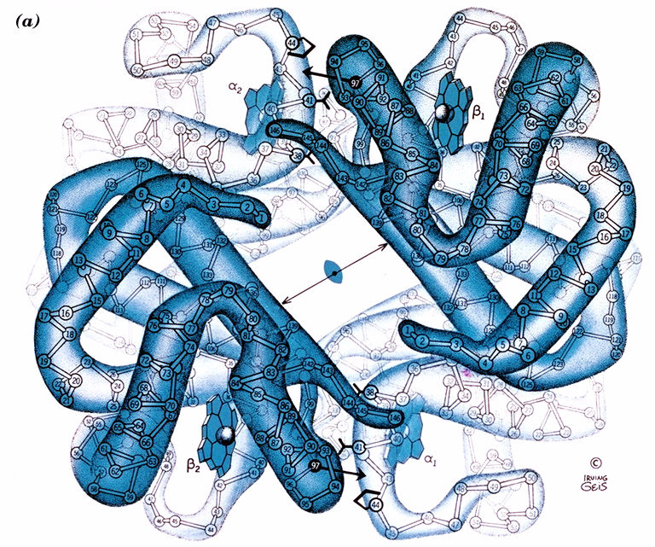

Slide 54
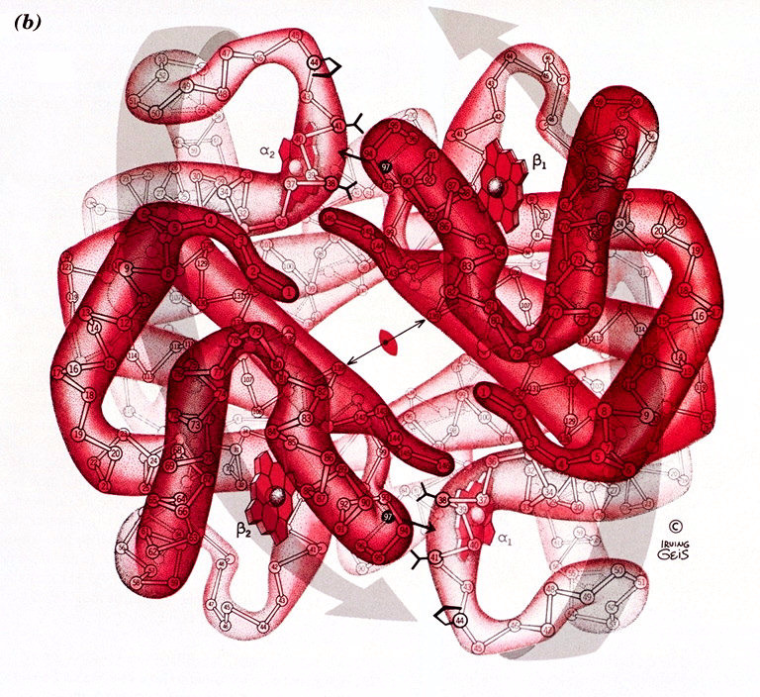

Slide 55
Chemistry Link to Health: Sickle-Cell Anemia (1 of 2)
Sickle-cell anemia is caused by an abnormality in the shape of one of the subunits of the hemoglobin protein.
The sixth amino acid in the
polar acidic glutamic
glutamic acid, is replaced by valine, a nonpolar amino acid.
The nonpolar R group on valine is attracted to the nonpolar regions within the beta hemoglobin chains.
The red blood cells change from a rounded shape to a crescent shape, like a sickle, which interferes with their ability to transport enough oxygen.

Slide 56
Chemistry Link to Health: Sickle-Cell Anemia (2 of 2)
Hydrophobic interactions also cause sickle-cell hemoglobin molecules to stick together. They form insoluble fibers of sickle-cell hemoglobin that
clog capillaries
cause inflammation, pain, and organ damage
cause low oxygen levels in the affected tissues

Slide 57
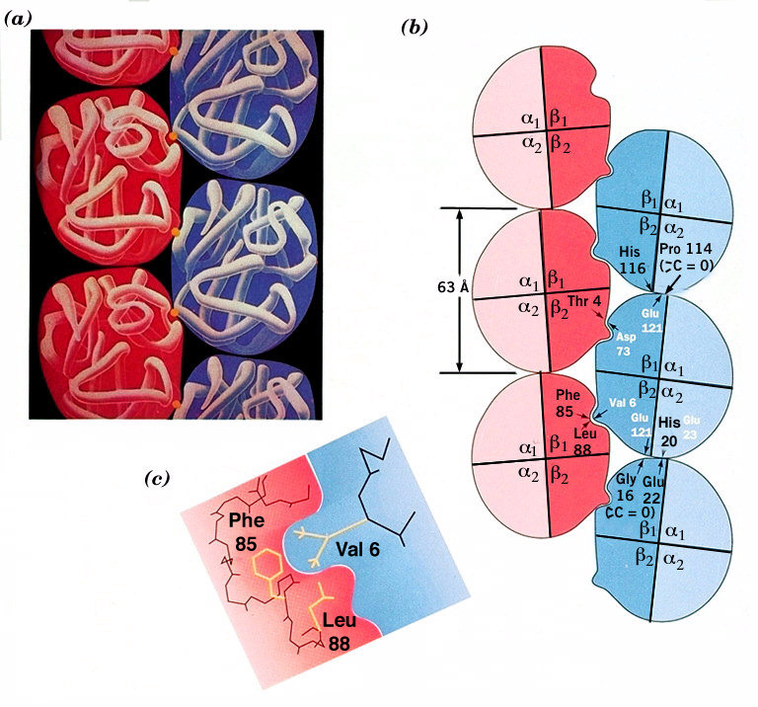

Slide 58
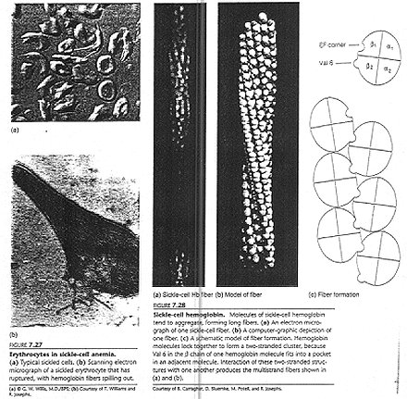

Slide 59
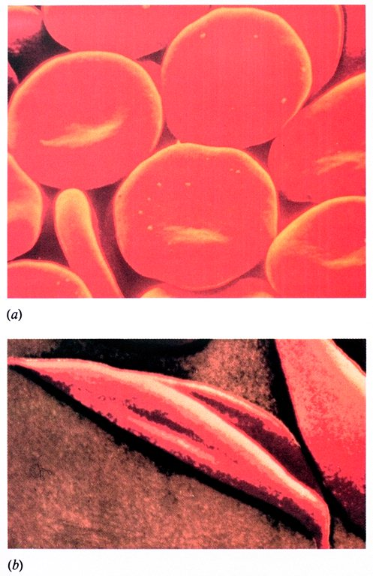

Slide 60
Protein Structural Levels—Summary
Table 16.5 Summary of Structural Levels in Proteins
Structural Level | Characteristics
Primary | Peptide bonds join amino acids in a specific sequence in a polypeptide.
Secondary | The alpha helix or beta-pleated sheet forms by hydrogen bonding between the atoms in the peptide backbone.
Tertiary | A polypeptide folds into a compact, three-dimensional shape stabilized by interactions (hydrogen bonds, salt bridges, hydrophobic, hydrophilic, disulfide) between R groups of amino acids to form a biologically active protein.
Quaternary | Two or more protein subunits combine and are stabilized by interactions (hydrogen bonds, salt bridges, hydrophobic, hydrophilic, disulfide) to form a biologically active protein.

Slide 61
Learning Check 3
Identify the level of protein structure.
primary
secondary
tertiary
quaternary
A. beta-pleated sheet
B. order of amino acids in a protein
C. a protein with two or more peptide chains
D. disulfide bonds between R groups

Slide 62
Solution 3
Identify the level of protein structure.
primary
secondary
tertiary
quaternary
A. beta-pleated sheet
secondary
B. order of amino acids in a protein
primary
C. a protein with two or more peptide chains
quaternary
D. disulfide bonds between R groups
tertiary

Slide 63
Denaturation of Proteins
Denaturation involves the disruption of bonds in the secondary, tertiary, and quaternary protein structures by
heat and organic compounds that break apart H bonds and disrupt hydrophobic interactions
acids and bases that break H bonds between polar R groups and disrupt ionic bonds
heavy metal ions that react with
bonds to form solids
agitation, such as whipping, that stretches peptide chains until bonds break

Slide 64
Applications of Denaturation
Denaturation of protein occurs when an egg is cooked.
Denaturation of egg protein occurs when the bonds of the tertiary structure are disrupted.
Notes:
For example, a rise in temperature causes denaturation of egg protein, disrupting the secondary and tertiary structures.

Slide 65
Protein Denaturation
Table 16.6 Protein Denaturation
Denaturing Agent | Bonds Disrupted | Examples
Heat Above 50 degrees Celsius | Hydrogen bonds; hydrophobic interactions between nonpolar R groups | Cooking food and autoclaving surgical items
Acids and Bases | Hydrogen bonds between polar R groups; salt bridges | Lactic acid from bacteria, which denatures milk protein in the preparation of yogurt and cheese
Organic Compounds | Hydrophobic interactions | Ethanol and isopropyl alcohol, which disinfect wounds and prepare the skin for injections
Heavy Metal Ions A g superscript plus, P b superscript 2 plus, and H g superscript 2 plus. | Disulfide bonds in proteins by forming ionic bonds | Mercury and lead poisoning
Agitation | Hydrogen bonds and hydrophobic interactions by stretching polypeptide chains and disrupting stabilizing interactions | Whipped cream, meringue made from egg whites

Slide 66
Learning Check 4
Tannic acid is used to form a scab on a burn. An egg is hard boiled by placing it in boiling water.
What is similar about these two events?

Slide 67
Solution 4
Tannic acid is used to form a scab on a burn. An egg is hard boiled by placing it in boiling water.
What is similar about these two events?
Acid and heat cause the denaturation of protein. They both break bonds in the secondary, tertiary, and quaternary structures of proteins.

Slide 68
16.4 Enzymes
Enzymes are proteins that act as biological catalysts. On the surface of an enzyme, a small region called an active site binds a substrate and catalyzes a specific reaction for that substrate.
Learning Goal Describe enzymes and their role in enzyme-catalyzed reactions.
Notes:
The enzyme substrate complex takes in a substrate and releases products. In an example, the enzyme substrate complex contains serine, lysine, valine, leucine, and alanine. A substrate enters the active site, a hydrophobic pocket in the enzyme. A hydrogen bond forms between serine in the enzyme and serine in the substrate. A salt bridge is formed between a carboxyl and an ammonia group and lysine in the enzyme-substrate complex. A benzene in the hydrophobic pocket is bonded to the substrate.

Slide 69
Enzymes Are Biological Catalysts
Enzymes
catalyze nearly all the chemical reactions taking place in the cells of the body
increase the rate of reaction by lowering the energy of activation
The enzyme carbonic anhydrase lowers the activation energy for the reaction:
Notes:
The plot for activation energy without enzyme has a higher peak than the plot for activation energy with enzyme. The difference between the energy levels of the products and the reactants represents the energy released by the reaction.

Slide 70
Enzyme Names
The name of an enzyme
is derived by replacing the end of the name of the reaction or reacting compound with the suffix ase
identifies the reacting substance—for example, sucrase catalyzes the reaction of sucrose
describes the compound or the reaction that is catalyzed—for example, oxidase catalyzes an oxidation reaction
could be a common name, particularly for the digestion enzymes, such as pepsin and trypsin

Slide 71
Classification of Enzymes
Enzymes are classified by the reaction they catalyze. There are six main classes of enzymes.
Class | Type of Reactions Catalyzed
Oxidoreductases | Oxidation–reduction
Transferases | Transfer groups of atoms
Hydrolases | Hydrolysis
Lyases | Add or remove atoms to or from a double bond
Isomerases | Rearrange atoms
Ligases | Use A T P to combine small molecules

Slide 72
Learning Check 1
Match the type of reaction catalyzed with an enzyme class.
hydrolases
isomerases
transferases
ligases
A. form bonds between molecules using A T P energy
B. rearrange atoms in a molecule to form an isomer
C. transfer a group between two compounds
D. hydrolysis reactions

Slide 73
Solution 1
Match the type of reaction catalyzed with an enzyme class.
hydrolases
isomerases
transferases
ligases
A. form bonds between molecules using A T P energy
ligases
B. rearrange atoms in a molecule to form an isomer
isomerases
C. transfer a group between two compounds
transferases
D. hydrolysis reactions
hydrolases

Slide 74
Active Site Binds the Substrate (1 of 2)
On the surface of an enzyme, a small region called an active site binds a substrate and catalyzes a reaction of that substrate.
Notes:
In an example enzyme substrate complex and the substrate in the active site, hydrogen bonds form between two serines. A salt bridge is formed between a carboxyl and an ammonia group. Benzene is situated in a hydrophobic pocket.

Slide 75
Active Site Binds the Substrate (2 of 2)
The active site
is a region within an enzyme that fits the shape of the reacting molecule called a substrate
contains amino acid R groups that bind the substrate
releases products when the reaction is complete

Slide 76
Enzyme-Catalyzed Reaction (1 of 2)
In an enzyme-catalyzed reaction,
a substrate attaches to the active site
an enzyme–substrate (E S) complex forms
reaction occurs and products are released
an enzyme is used over and over
Binding of a substrate occurs when it interacts with the amino acids within the active site.
Notes:
In an example enzyme substrate complex and the substrate in the active site, hydrogen bonds form between two serines. A salt bridge is formed between a carboxyl and an ammonia group. Benzene is situated in a hydrophobic pocket.

Slide 77
Enzyme-Catalyzed Reaction (2 of 2)
In the hydrolysis of the disaccharide lactose,
the E S complex is formed as lactose binds to the active site of lactase
the glycosidic bond of lactose is in position for hydrolysis
the R groups on the amino acids in the active site catalyze the hydrolysis of lactose, producing glucose and galactose
the product structures are no longer attracted to the active site, so they are released to allow lactase to react with another lactose molecule

Slide 78
Enzyme Action: Lock-and-Key Model
In the lock-and-key model, the
active site has a rigid, nonflexible shape
enzyme binds only substrates that exactly fit the active site like a lock
substrate is the key that fits that lock
This model was a static one that did not include the flexibility of the tertiary shape of an enzyme and the way the active site can adjust to the shape of a substrate.

Slide 79
Enzyme Action: Induced-Fit Model (1 of 2)
In the induced-fit model,
enzyme structure is flexible, not rigid, and adjusts to the shape of the active site in order to bind the substrate
the range of substrate specificity increases
shape changes improve catalysis during reaction

Slide 80
Enzyme Action: Induced-Fit Model (2 of 2)
In the induced-fit model, substrate and enzyme work together to acquire a geometrical arrangement that lowers the activation energy of the reaction.
Notes:
Lactose bonds to the active site in the enzyme lactase, E, creating an enzyme-substrate complex, E S. H 2 O breaks the bond between the 2 sugars and they are released as products, P. The enzyme now has an open active site and the cycle repeats.

Slide 81
Chemistry Link to Health: Isoenzymes as Diagnostic Tools (1 of 4)
Isoenzymes
are different forms of an enzyme that catalyze the same reaction in different cells or tissues of the body
consist of quaternary structures with slight variations in the amino acids in the polypeptide subunits
There are five isoenzymes of lactate dehydrogenase (L D H) that catalyze the conversion between lactate and pyruvate.

Slide 82
Chemistry Link to Health: Isoenzymes as Diagnostic Tools (2 of 4)
Each L D H isoenzyme contains a mix of polypeptide subunits, M and H. Different combinations of M and H are used to convert lactate to pyruvate in different organs.
In the liver and muscle, lactate is converted to pyruvate by
the
isoenzyme with four M subunits
In the heart, the same reaction is catalyzed by the
isoenzyme
containing four H subunits.

Slide 83
Chemistry Link to Health: Isoenzymes as Diagnostic Tools (3 of 4)
A myocardial infarction may be indicated by an increase in the levels of creatine kinase (C K) and lactate dehydrogenase (L D H).
When a myocardial infarction (M I) or heart attack damages
heart muscle, an increase in the level of
isoenzyme is detected in the blood serum.
An elevation in serum
indicates liver damage or
disease.

Slide 84
Chemistry Link to Health: Isoenzymes as Diagnostic Tools (4 of 4)
The different isoenzymes of lactate dehydrogenase (L D H) indicate damage to different organs in the body.
Notes:
Isoenzymes of Lactate Dehydrogenase Highest Levels Found in the Following
H 4, L D H 1 Heart, Kidneys
H 3 M, L D H 2 Red blood cells, heart, kidneys, brain
H 2 M 2, L D H 3 Brain, lung, white blood cells
H M 3, L D H 4 Lung, skeletal muscle
M 4, L D H 5 Skeletal muscle, liver

Slide 85
Learning Check 2
The active site is
A. the enzyme
B. a section of the enzyme
C. the substrate
In the induced-fit model, the shape of the enzyme when substrate binds
A. stays the same
B. adapts to the shape of the substrate

Slide 86
Solution 2
The active site is
B. a section of the enzyme
In the induced-fit model, the shape of the enzyme when substrate binds
B. adapts to the shape of the substrate

Slide 87
16.5 Factors Affecting Enzyme Activity
The activity of an enzyme
describes how fast an enzyme catalyzes the reaction that converts a substrate to product
is strongly affected by reaction conditions, which include temperature, p H, and the presence of inhibitors
Thermophiles survive in the high temperatures
of a hot spring.
Learning Goal Describe the effect of temperature, p H, and inhibitors on enzyme activity.

Slide 88
Temperature and Enzyme Activity
Enzymes
are most active at an optimum temperature
(usually
in humans)
show little activity at low temperatures.
lose activity at temperatures
above
as denaturation
occurs with loss of catalytic activity
Notes:
The graph rises with increasing then decreasing steepness to a maximum enzyme activity point for optimum temperature at 37 degrees, and then falls with increasing steepness to the point of denaturation at 51 degrees. All values estimated.

Slide 89
p H and Enzyme Activity
Enzymes
are most active at optimum p H
contain R groups of amino acids with proper charges at optimum p H
lose activity in low or high p H as tertiary structure is disrupted

Slide 90
Optimum p H Values
Enzymes in
the body have an optimum p H of about 7.4
certain organs operate at lower and higher optimum p H values
Table 16.10 Optimum p H for Selected Enzymes
Enzyme | Location | Substrate | Optimum p H
Pepsin | Stomach | Peptide bonds | 1.5–2.0
Lactase | G I tract | Lactose | 6.0
Sucrase | Small intestine | Sucrose | 6.2
Amylase | Pancreas | Amylose | 6.7–7.0
Urease | Liver | Urea | 7.0
Trypsin | Small intestine | Peptide bonds | 7.7–8.0
Lipase | Pancreas | Lipid (ester bonds) | 8.0
Arginase | Liver | Arginine | 9.7

Slide 91
Learning Check 1
Sucrase has an optimum temperature of
and an
optimum p H of 6.2. Determine the impact of each change on the enzyme activity.
no change increases decreases
A. changing the p H to 4
B. running the reaction at

Slide 92
Solution 1
Sucrase has an optimum temperature of
and an
optimum p H of 6.2. Determine the impact of each change on the enzyme activity.
no change increases decreases
A. changing the p H to 4
decreases
B. running the reaction at
decreases

Slide 93
Enzyme Inhibition
Inhibitors
are molecules that cause a loss of catalytic activity
prevent substrates from fitting into the active sites

Slide 94
Competitive Inhibition (1 of 2)
A competitive inhibitor
has a structure that is similar to that of the substrate
competes with the substrate for the active site
has its effect reversed by increasing substrate concentration

Slide 95
Competitive Inhibition (2 of 2)
Notes:
The substrate is converted to a product, P, and the product is released, leaving an enzyme with an open active site. An enzyme + an inhibitor, I, creates an enzyme-inhibitor complex, E I. The competitive inhibitor in the active site prevents the binding of substrate.

Slide 96
Noncompetitive Inhibition (1 of 2)
A noncompetitive inhibitor
has a structure that is much different than that of the substrate
binds to an enzyme at a site other than the active site and distorts the shape of the enzyme by altering the shape of the active site
prevents the binding of the substrate
cannot have its effect reversed by adding more substrate

Slide 97
Noncompetitive Inhibition (2 of 2)
Notes:
The substrate is converted to a product, creating an enzyme-product complex, E P. The product is released, leaving an enzyme with an open active site. An enzyme + an inhibitor, I, creates an enzyme-inhibitor complex, E I. The change in shape of the active site caused by the noncompetitive inhibitor prevents the binding of substrate.

Slide 98
Irreversible Inhibition
An irreversible inhibitor
is a molecule that causes the enzyme to lose all activity
is often a toxic substance that destroys enzymes
usually forms a covalent bond with an amino acid side chain preventing catalytic activity
may be a nerve gas, an insecticide, or an antibiotic
Notes:
● Penicillin G, phenyl single bond C H 2 single bond.
● Penicillin V, phenyl single bond O single bond C H 2 single bond.
● Ampicillin, phenyl single bond C H which is single bonded to a N H 2 and has another single bond.
● Ampicillin, O H single bond benzene, in para configuration, single bond C H which is single bonded to a N H 2 and has another single bond.

Slide 99
Competitive, Noncompetitive, and Irreversible Inhibitors
Table 16.11 Summary of Competitive, Noncompetitive, and Irreversible Inhibitors
Characteristics | Competitive | Noncompetitive | Irreversible
Shape of Inhibitor | Similar shape to the substrate | Does not have a similar shape to the substrate | Does not have a similar shape to the substrate
Binding to Enzyme | Competes for and binds at the active site | Binds away from the active site to change the shape of the enzyme and its activity | Forms a covalent bond with the enzyme
Reversibility | Adding more substrate reverses the inhibition | Not reversed by adding more substrate, but by a chemical change that removes the inhibitor | Permanent, not reversible

Slide 100
Learning Check 2
Identify each description as an inhibitor that is competitive or noncompetitive.
A. Increasing substrate reverses inhibition.
B. It binds to enzyme surface but not to the active site.
C. Its structure is similar to that of substrate.
D. Inhibition is not reversed by adding more substrate.

Slide 101
Solution 2
A. Increasing substrate reverses inhibition.
competitive
B. It binds to enzyme surface but not to the active site.
noncompetitive
C. Its structure is similar to that of substrate.
competitive
D. Inhibition is not reversed by adding more substrate.
noncompetitive

Slide 102
Proteins—Concept Map
Notes:
● Proteins contain amino acids that have ammonium, carboxylate, and r Groups.
● Proteins contain peptide bonds between amino acids in a specific order as primary structure and hydrogen bond as secondary structure with interactions that give tertiary and quaternary structures are active as enzymes.
● Proteins are used for structure, transport, hormones, storage, and as enzymes which bind substrate at active sites to form an E S Complex that is blocked by inhibitors.
● Proteins undergo denaturation by heath, acids, bases, organic compounds, that change secondary or tertiary structures of proteins.

